Slide 1
Chapter 1

Slide 2
OPERATING SYSTEMS:
Objectives:
Convenience for the user.
Efficient operation of the computer.
Ability to evolve.
1 and 2 conflict. So we look for compromises between them based on machine usage (WindowsNT 3.51 vs WindowsNT 4.0 or Windows 98 vs Windows XP).
Notes:
According to some authors, the OS is the kernel and everything else is an application.
What about loadable device drivers (i.e. modules in Linux) vs monolithic kernels?

Slide 3
OPERATING SYSTEMS:
Tasks:
  Program development (Command-interpreter (shell), GUI, etc).
  Program management/execution.
  I/O device management.
  File management.
  System access (main memory management, networking, etc).
  Error detection.
  Accounting.
  Protection <- missed by our author!
  Shared memory (SMP systems).
  Message passing (distributed systems).
  Services in italics are not provided by all OS.

Slide 4
OPERATING SYSTEMS:
Dual-mode Operation (Two levels of commands):
1. User mode – Given to users and their programs.
2. Privileged mode – Given to the OS.
All I/O instructions are privileged instructions. User’s programs that require I/O must request the I/O from the OS.
CPU protection is provided by a timer (To prevent a program with an infinite loop from hogging the CPU for evermore. Obviously this timer cannot protect the user from an infinite loop).
Discussion: Since the OS is given unrestricted access to the system (memory, CPU, disk, etc), could a terrorist organization use this to crash America’s information network.

Slide 5
OPERATING SYSTEMS:
Structure:
A well structured OS design improves maintainability, can simply the design and development process, and eases verification and validation. Generally, well structured means a layered design.
However, layering decreases efficiency by forcing extra function calls (each function call typically requires storage of the machine's state).
Examples:
  MSDOS – Poorly structured. Levels of functionality and interfaces are net well defined or separated. User written programs can directly access the hardware (and sometimes, they have too!).
  UNIX – Originally, had little structuring (not much better than MSDOS). Newer versions have better / more structuring (The Mach microkernel takes structuring to the extreme).
  OS/2 – Arguably the best OS design to date (for PC’s at least).

Slide 6
OPERATING SYSTEMS:
Types:
1. Batch systems.
  Jobs sorted by hand (assuming the job control card was filled out accurately)
  Jobs were primarily CPU intensive (only I/O was tape and paper printout)
  Spoolers are batch systems.
2. Multi-programmed batch systems.
  Use a job pool (on tape, disk, or in memory) to allow better use of system resources. Jobs are swapped in and out to keep CPU busy.
  Requires some form of job scheduling.
3. Time-sharing.
  Time limit or I/O causes a job swap.
  Requires an on-line file system (disk).
  Provides an interactive environment.
Discussion:
  Batch systems matched up well with the hardware of the time. The only common I/O were tape drives and printers. CPUs were slow and memory was very expensive.
  Supercomputers still use the multi-programmed batch system. Why?
  Most modern OS are time-sharing and swap times can be a concern.

Slide 7
OPERATING SYSTEMS:
Parallel systems:
Asymmetric – Different processors have different tasks.
Front-end machine – like a keyboard buffer.
Back end machine – like a disk controller chip or graphics accelerator chip.
Symmetric – (SMP) Processors run identical copies of the OS, but the actual jobs may be different.
The Safeguard site in ND.
Distributed systems:
Each processing node is a different machine, all connected by a network.
A Linux print server would fall into this category.

Slide 8
INTERRUPTS:
Four Types:
1. Software – Generated by the software (system calls).
2. Timers – Generated by timer (ie CPU).
3. I/O – Generated by an I/O controller.
4. Hardware – Generated by the hardware (usually for some failure).
Notes:
Interrupts disable (delay) other activities until the current interrupt has finished.
Interrupts force the machine state to be saved (costs CPU cycles).
Interrupt service (interrupt-handler) routine locations (addresses) may be stored in a look-up-table (LUT) called an interrupt vector (DOS and UNIX). The idea is to speed up interrupt service execution.

Slide 9
MEMORY HIERARCHY:
Faster
but
expensive
Registers
words
On-chip (level 1) cache
pages*
Off-chip (level 2) cache
pages*
Memory (DRAM)
disk blocks
Secondary storage (disk drives)
files
Tertiary storage (tape drives)
Slower
but
cheaper
* In many systems disk blocks = pages.

Slide 10
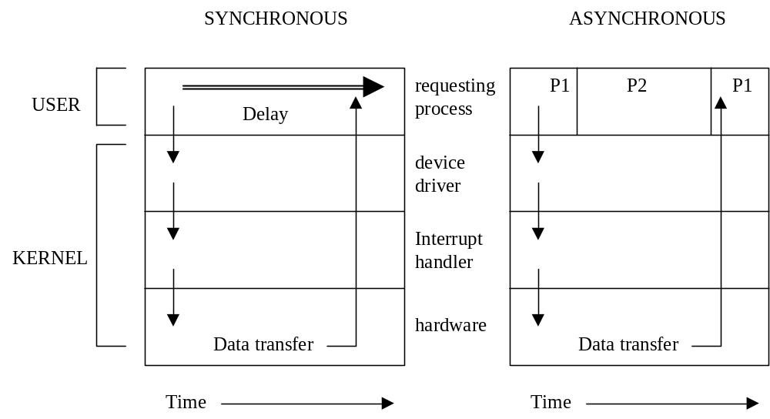
I/O:
Three Types:
1. Programmed – synchronous.
2. Interrupt driven – asynchronous.
3. DMA – Direct Memory Access.

Slide 11
I/O:
DMA:
Due to the overhead associated with I/O (transfer a byte, check for errors, set flags and pointers, etc) a faster method of data transfer can be of use. This is especially true for devices that must transfer large blocks of data into main memory.
The DMA device transfers data on its own to the appropriate memory locations. The CPU is left free to do other tasks.
However, since the memory controller can only transfer 1 word at a time, if the CPU requires memory access it will be delayed until the DMA transfer is completed.
Memory-mapped I/O and ports:
Memory-mapped I/O and ports are primarily used to ease access to the various devices.

Slide 12
OS HISTORIES:
Unix History:
http://www.youtube.com/watch?v=7FjX7r5icV8&feature=related

Slide 13
